Slide 1
Procedurally Generated Voxel Terrain
Paul noonan

Slide 2
Research
Perlin Noise
Generating Terrain
Voronoi Diagrams
Identifying Biome areas

Slide 3
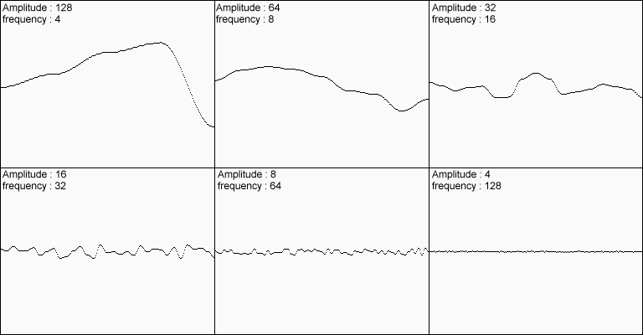
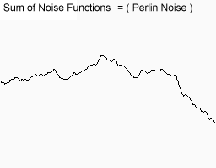
Perlin Noise
Amplitude
Frequency
Octaves
Persistence

Slide 4
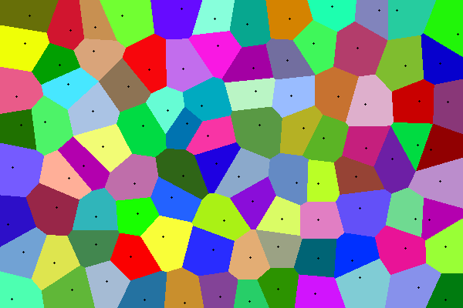
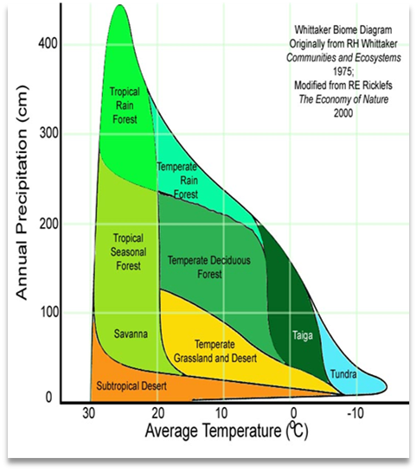
Voronoi Diagrams
Nodes / Cells
Defined areas
Biomes
Borders

Slide 5
Current Progress
Generating a 2D array of Perlin Noise
Generating a ‘chunk’
Instantiating cubes inside the at each position of the array
All cubes are textured by a set of UV values which relate to a tile map
All cubes mesh filters are combined, removed and applied to the ‘chunk’ as one
Pick up on players position to generate surrounding chunks

Slide 6
Next Step
All cubes have to be generated through code
All cubes must have knowledge of their surrounding cubes
Chunk mesh generated from new cube vertices
Biomes with Voronoi & Whittaker diagrams
Biome blending

Slide 7
Prototype

Slide 8
Thank you

